Slide 1
Tutorial 10 RISC-V Single Cycle
Maroun Tork, 2018

Slide 2
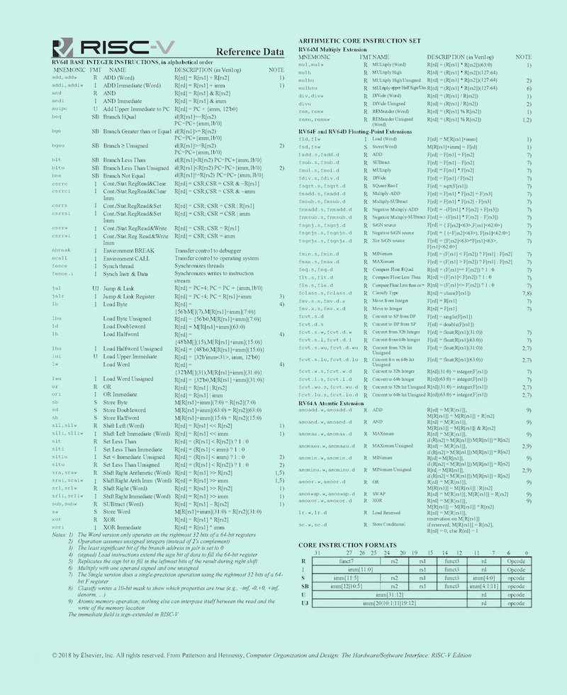

Slide 3
Single-Cycle RISC-V RV32I Datapath
+4
Reg[]
pc
pc+4
pc
wb
1
alu
1
DataD
Reg[rs1]
ALU
2
alu
0
DMEM
0
IMEM
inst[11:7]
AddrD
Addr
1
pc+4
Branch Comp.
Reg[rs2]
DataR
wb
inst[19:15]
AddrA
DataA
0
0
DataW
mem
inst[24:20]
AddrB
DataB
1
inst[31:7]
Imm.
Gen
ALU ctrl
imm[31:0]
funct 3,7
PCSel
inst[14:12|6:2]
ImmSel
RegWEn
BrUn
BrEq
BrLT
BSel
ASel
ALUSel
MemRW
WBSel

Slide 4
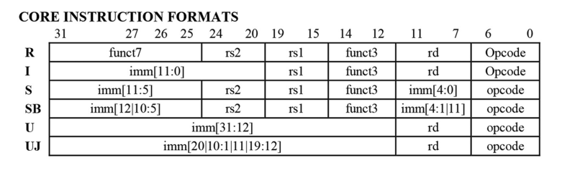

Slide 5
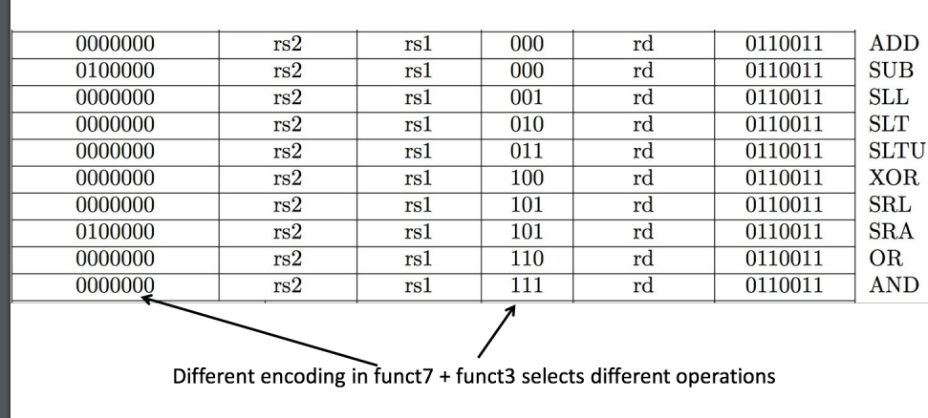
R-type

Slide 6
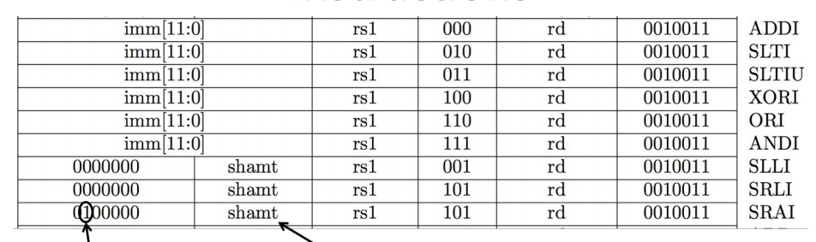
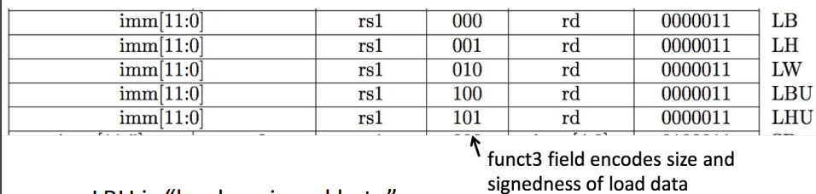
I-type
Immediate or load

Slide 7
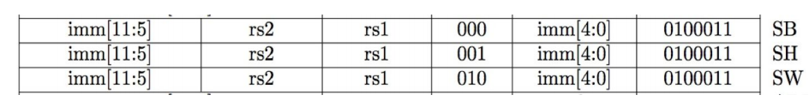
S-type
Store

Slide 8
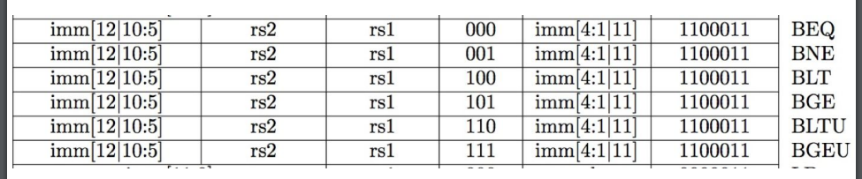
SB-type
Branch

Slide 9
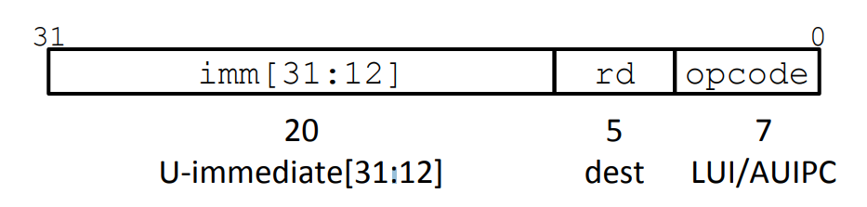
U-type
Upper immediate

Slide 10
UJ-type

Slide 11
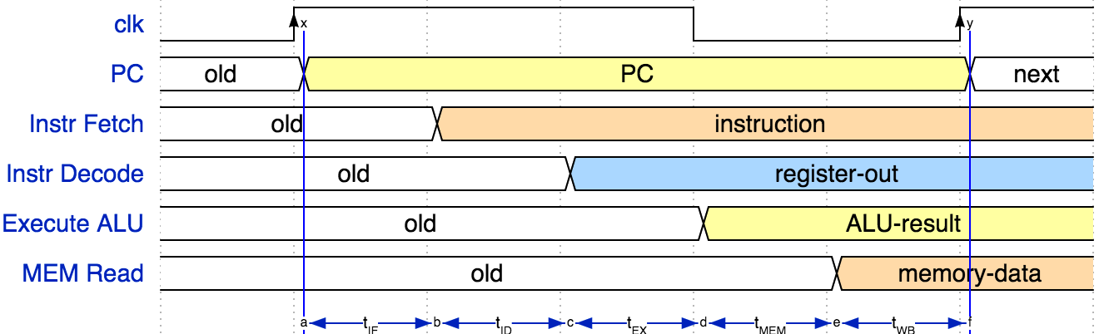
Instruction Timing

Slide 12
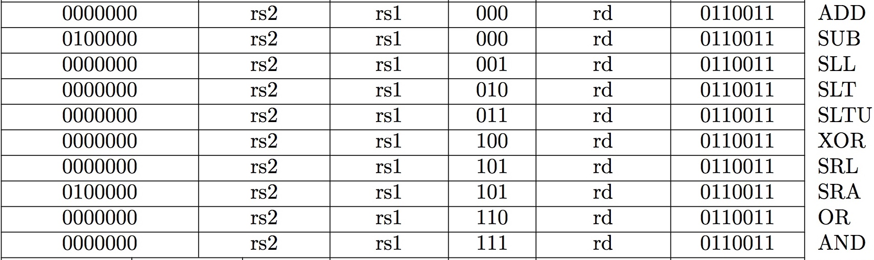
Implementing the add instruction
add rd, rs1, rs2
Instruction makes two changes to machine’s state:
Reg[rd] = Reg[rs1] + Reg[rs2]
PC = PC + 4

Slide 13
Single-Cycle RISC-V RV32I Datapath
add rd, rs1, rs2
+4
Reg[]
pc
pc+4
pc
wb
1
alu
1
DataD
Reg[rs1]
ALU
2
alu
0
DMEM
0
IMEM
inst[11:7]
AddrD
Addr
1
pc+4
Branch Comp.
Reg[rs2]
DataR
wb
inst[19:15]
AddrA
DataA
0
0
DataW
mem
inst[24:20]
AddrB
DataB
1
inst[31:7]
Imm.
Gen
ALU ctrl
imm[31:0]
funct 3,7
PCSel
inst[14:12|6:2]
ImmSel
RegWEn
BrUn
BrEq
BrLT
BSel
ASel
ALUSel
MemRW
WBSel

Slide 14
Single-Cycle RISC-V RV32I Datapath
add rd, rs1, rs2
+4
Reg[]
pc
pc+4
pc
wb
1
alu
1
DataD
Reg[rs1]
ALU
2
alu
0
DMEM
0
IMEM
inst[11:7]
AddrD
Addr
1
pc+4
Branch Comp.
Reg[rs2]
DataR
wb
inst[19:15]
AddrA
DataA
0
0
DataW
mem
inst[24:20]
AddrB
DataB
1
inst[31:7]
Imm.
Gen
ALU ctrl
imm[31:0]
funct 3,7
PCSel
inst[14:12|6:2]
ImmSel
RegWEn
BrUn
BrEq
BrLT
BSel
ASel
ALUSel
MemRW
WBSel

Slide 15
Single-Cycle RISC-V RV32I Datapath
add rd, rs1, rs2
+4
Reg[]
pc
pc+4
pc
wb
1
alu
1
DataD
Reg[rs1]
ALU
2
alu
0
DMEM
0
IMEM
inst[11:7]
AddrD
Addr
1
pc+4
Branch Comp.
Reg[rs2]
DataR
wb
inst[19:15]
AddrA
DataA
0
0
DataW
mem
inst[24:20]
AddrB
DataB
1
inst[31:7]
Imm.
Gen
ALU ctrl
imm[31:0]
funct 3,7
PCSel
inst[14:12|6:2]
ImmSel
RegWEn
BrUn
BrEq
BrLT
BSel
ASel
ALUSel
MemRW
WBSel

Slide 16
Single-Cycle RISC-V RV32I Datapath
add rd, rs1, rs2
+4
Reg[]
pc
pc+4
pc
wb
1
alu
1
DataD
Reg[rs1]
ALU
2
alu
0
DMEM
0
IMEM
inst[11:7]
AddrD
Addr
1
pc+4
Branch Comp.
Reg[rs2]
DataR
wb
inst[19:15]
AddrA
DataA
0
0
DataW
mem
inst[24:20]
AddrB
DataB
1
inst[31:7]
Imm.
Gen
ALU ctrl
imm[31:0]
funct 3,7
PCSel
inst[14:12|6:2]
ImmSel
RegWEn
BrUn
BrEq
BrLT
BSel
ASel
ALUSel
MemRW
WBSel

Slide 17
Single-Cycle RISC-V RV32I Datapath
add rd, rs1, rs2
+4
Reg[]
pc
pc+4
pc
wb
1
alu
1
DataD
Reg[rs1]
ALU
2
alu
0
DMEM
0
IMEM
inst[11:7]
AddrD
Addr
1
pc+4
Branch Comp.
Reg[rs2]
DataR
wb
inst[19:15]
AddrA
DataA
0
0
DataW
mem
inst[24:20]
AddrB
DataB
1
inst[31:7]
Imm.
Gen
ALU ctrl
imm[31:0]
funct 3,7
PCSel
inst[14:12|6:2]
ImmSel
RegWEn
BrUn
BrEq
BrLT
BSel
ASel
ALUSel
MemRW
WBSel

Slide 18
Single-Cycle RISC-V RV32I Datapath
add rd, rs1, rs2
+4
Reg[]
pc
pc+4
pc
wb
1
alu
1
DataD
Reg[rs1]
ALU
2
alu
0
DMEM
0
IMEM
inst[11:7]
AddrD
Addr
1
pc+4
Branch Comp.
Reg[rs2]
DataR
wb
inst[19:15]
AddrA
DataA
0
0
DataW
mem
inst[24:20]
AddrB
DataB
1
Add
inst[31:7]
Imm.
Gen
ALU ctrl
imm[31:0]
0
funct 3,7
1
d
0
0
R
Read
01
d
PCSel
inst[14:12|6:2]
ImmSel
RegWEn
BrUn
BrEq
BrLT
BSel
ASel
ALUSel
MemRW
WBSel

Slide 19
Single-Cycle RISC-V RV32I Datapath
addi rd, rs1, imm
+4
Reg[]
pc
pc+4
pc
wb
1
alu
1
DataD
Reg[rs1]
ALU
2
alu
0
DMEM
0
IMEM
inst[11:7]
AddrD
Addr
1
pc+4
Branch Comp.
Reg[rs2]
DataR
wb
inst[19:15]
AddrA
DataA
0
0
DataW
mem
inst[24:20]
AddrB
DataB
1
Add
inst[31:7]
Imm.
Gen
ALU ctrl
imm[31:0]
0
funct 3,7
1
d
0
0
R
Read
01
d
PCSel
inst[14:12|6:2]
ImmSel
RegWEn
BrUn
BrEq
BrLT
BSel
ASel
ALUSel
MemRW
WBSel

Slide 20
Single-Cycle RISC-V RV32I Datapath
addi rd, rs1, imm
+4
Reg[]
pc
pc+4
pc
wb
1
alu
1
DataD
Reg[rs1]
ALU
2
alu
0
DMEM
0
IMEM
inst[11:7]
AddrD
Addr
1
pc+4
Branch Comp.
Reg[rs2]
DataR
wb
inst[19:15]
AddrA
DataA
0
0
DataW
mem
inst[24:20]
AddrB
DataB
1
Add
inst[31:7]
Imm.
Gen
ALU ctrl
imm[31:0]
0
funct 3,7
i
1
d
0
0
R
Read
01
PCSel
inst[14:12|6:2]
ImmSel
RegWEn
BrUn
BrEq
BrLT
BSel
ASel
ALUSel
MemRW
WBSel

Slide 21
Single-Cycle RISC-V RV32I Datapath
addi rd, rs1, imm
+4
Reg[]
pc
pc+4
pc
wb
1
alu
1
DataD
Reg[rs1]
ALU
2
alu
0
DMEM
0
IMEM
inst[11:7]
AddrD
Addr
1
pc+4
Branch Comp.
Reg[rs2]
DataR
wb
inst[19:15]
AddrA
DataA
0
0
DataW
mem
inst[24:20]
AddrB
DataB
1
Add
inst[31:7]
Imm.
Gen
ALU ctrl
imm[31:0]
0
funct 3,7
i
1
d
1
0
i
Read
01
PCSel
inst[14:12|6:2]
ImmSel
RegWEn
BrUn
BrEq
BrLT
BSel
ASel
ALUSel
MemRW
WBSel

Slide 22
Implementing Load Word instruction
lw x14, 8(x2)
000000001000
00010
010
01110
0000011
imm=+8
rs1=2
LW
rd=14
LOAD

Slide 23
Single-Cycle RISC-V RV32I Datapath
lw rd, imm(rs1)
+4
Reg[]
pc
pc+4
pc
wb
1
alu
1
DataD
Reg[rs1]
ALU
2
alu
0
DMEM
0
IMEM
inst[11:7]
AddrD
Addr
1
pc+4
Branch Comp.
Reg[rs2]
DataR
wb
inst[19:15]
AddrA
DataA
0
0
DataW
mem
inst[24:20]
AddrB
DataB
1
inst[31:7]
Imm.
Gen
ALU ctrl
imm[31:0]
funct 3,7
PCSel
inst[14:12|6:2]
ImmSel
RegWEn
BrUn
BrEq
BrLT
BSel
ASel
ALUSel
MemRW
WBSel

Slide 24
Single-Cycle RISC-V RV32I Datapath
lw rd, imm(rs1)
+4
Reg[]
pc
pc+4
pc
wb
1
alu
1
DataD
Reg[rs1]
ALU
2
alu
0
DMEM
0
IMEM
inst[11:7]
AddrD
Addr
1
pc+4
Branch Comp.
Reg[rs2]
DataR
wb
inst[19:15]
AddrA
DataA
0
0
DataW
mem
inst[24:20]
AddrB
DataB
1
inst[31:7]
Imm.
Gen
ALU ctrl
imm[31:0]
funct 3,7
PCSel
inst[14:12|6:2]
ImmSel
RegWEn
BrUn
BrEq
BrLT
BSel
ASel
ALUSel
MemRW
WBSel

Slide 25
Single-Cycle RISC-V RV32I Datapath
lw rd, imm(rs1)
+4
Reg[]
pc
pc+4
pc
wb
1
alu
1
DataD
Reg[rs1]
ALU
2
alu
0
DMEM
0
IMEM
inst[11:7]
AddrD
Addr
1
pc+4
Branch Comp.
Reg[rs2]
DataR
wb
inst[19:15]
AddrA
DataA
0
0
DataW
mem
inst[24:20]
AddrB
DataB
1
inst[31:7]
Imm.
Gen
ALU ctrl
imm[31:0]
funct 3,7
PCSel
inst[14:12|6:2]
ImmSel
RegWEn
BrUn
BrEq
BrLT
BSel
ASel
ALUSel
MemRW
WBSel

Slide 26
Single-Cycle RISC-V RV32I Datapath
lw rd, imm(rs1)
+4
Reg[]
pc
pc+4
pc
wb
1
alu
1
DataD
Reg[rs1]
ALU
2
alu
0
DMEM
0
IMEM
inst[11:7]
AddrD
Addr
1
pc+4
Branch Comp.
Reg[rs2]
DataR
wb
inst[19:15]
AddrA
DataA
0
0
DataW
mem
inst[24:20]
AddrB
DataB
1
inst[31:7]
Imm.
Gen
ALU ctrl
imm[31:0]
funct 3,7
PCSel
inst[14:12|6:2]
ImmSel
RegWEn
BrUn
BrEq
BrLT
BSel
ASel
ALUSel
MemRW
WBSel

Slide 27
Single-Cycle RISC-V RV32I Datapath
lw rd, imm(rs1)
+4
Reg[]
pc
pc+4
pc
wb
1
alu
1
DataD
Reg[rs1]
ALU
2
alu
0
DMEM
0
IMEM
inst[11:7]
AddrD
Addr
1
pc+4
Branch Comp.
Reg[rs2]
DataR
wb
inst[19:15]
AddrA
DataA
0
0
DataW
mem
inst[24:20]
AddrB
DataB
1
inst[31:7]
Imm.
Gen
ALU ctrl
imm[31:0]
funct 3,7
PCSel
inst[14:12|6:2]
ImmSel
RegWEn
BrUn
BrEq
BrLT
BSel
ASel
ALUSel
MemRW
WBSel

Slide 28
Single-Cycle RISC-V RV32I Datapath
lw rd, imm(rs1)
+4
Reg[]
pc
pc+4
pc
wb
1
alu
1
DataD
Reg[rs1]
ALU
2
alu
0
DMEM
0
IMEM
inst[11:7]
AddrD
Addr
1
pc+4
Branch Comp.
Reg[rs2]
DataR
wb
inst[19:15]
AddrA
DataA
0
0
DataW
mem
inst[24:20]
AddrB
DataB
1
Add
inst[31:7]
Imm.
Gen
ALU ctrl
imm[31:0]
0
funct 3,7
i
1
d
1
0
i
Read
00
PCSel
inst[14:12|6:2]
ImmSel
RegWEn
BrUn
BrEq
BrLT
BSel
ASel
ALUSel
MemRW
WBSel

Slide 29
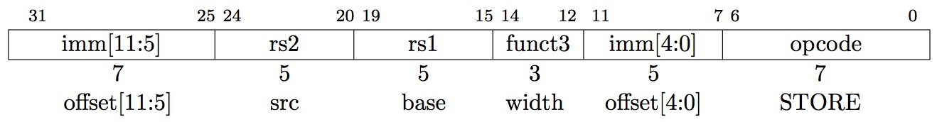
Implementing Store Word instruction
sw x14, 8(x2)
0000000
01110
00010
010
01000
0100011
offset[11:5]
rs2=14
rs1=2
SW
offset[4:0]
STORE

Slide 30
Single-Cycle RISC-V RV32I Datapath
sw rs2, imm(rs1)
+4
Reg[]
pc
pc+4
pc
wb
1
alu
1
DataD
Reg[rs1]
ALU
2
alu
0
DMEM
0
IMEM
inst[11:7]
AddrD
Addr
1
pc+4
Branch Comp.
Reg[rs2]
DataR
wb
inst[19:15]
AddrA
DataA
0
0
DataW
mem
inst[24:20]
AddrB
DataB
1
inst[31:7]
Imm.
Gen
ALU ctrl
imm[31:0]
funct 3,7
PCSel
inst[14:12|6:2]
ImmSel
RegWEn
BrUn
BrEq
BrLT
BSel
ASel
ALUSel
MemRW
WBSel

Slide 31
Single-Cycle RISC-V RV32I Datapath
sw rs2, imm(rs1)
+4
Reg[]
pc
pc+4
pc
wb
1
alu
1
DataD
Reg[rs1]
ALU
2
alu
0
DMEM
0
IMEM
inst[11:7]
AddrD
Addr
1
pc+4
Branch Comp.
Reg[rs2]
DataR
wb
inst[19:15]
AddrA
DataA
0
0
DataW
mem
inst[24:20]
AddrB
DataB
1
inst[31:7]
Imm.
Gen
ALU ctrl
imm[31:0]
funct 3,7
PCSel
inst[14:12|6:2]
ImmSel
RegWEn
BrUn
BrEq
BrLT
BSel
ASel
ALUSel
MemRW
WBSel

Slide 32
Single-Cycle RISC-V RV32I Datapath
sw rs2, imm(rs1)
+4
Reg[]
pc
pc+4
pc
wb
1
alu
1
DataD
Reg[rs1]
ALU
2
alu
0
DMEM
0
IMEM
inst[11:7]
AddrD
Addr
1
pc+4
Branch Comp.
Reg[rs2]
DataR
wb
inst[19:15]
AddrA
DataA
0
0
DataW
mem
inst[24:20]
AddrB
DataB
1
inst[31:7]
Imm.
Gen
ALU ctrl
imm[31:0]
funct 3,7
PCSel
inst[14:12|6:2]
ImmSel
RegWEn
BrUn
BrEq
BrLT
BSel
ASel
ALUSel
MemRW
WBSel

Slide 33
Single-Cycle RISC-V RV32I Datapath
sw rs2, imm(rs1)
+4
Reg[]
pc
pc+4
pc
wb
1
alu
1
DataD
Reg[rs1]
ALU
2
alu
0
DMEM
0
IMEM
inst[11:7]
AddrD
Addr
1
pc+4
Branch Comp.
Reg[rs2]
DataR
wb
inst[19:15]
AddrA
DataA
0
0
DataW
mem
inst[24:20]
AddrB
DataB
1
inst[31:7]
Imm.
Gen
ALU ctrl
imm[31:0]
funct 3,7
PCSel
inst[14:12|6:2]
ImmSel
RegWEn
BrUn
BrEq
BrLT
BSel
ASel
ALUSel
MemRW
WBSel

Slide 34
Single-Cycle RISC-V RV32I Datapath
sw rs2, imm(rs1)
+4
Reg[]
pc
pc+4
pc
wb
1
alu
1
DataD
Reg[rs1]
ALU
2
alu
0
DMEM
0
IMEM
inst[11:7]
AddrD
Addr
1
pc+4
Branch Comp.
Reg[rs2]
DataR
wb
inst[19:15]
AddrA
DataA
0
0
DataW
mem
inst[24:20]
AddrB
DataB
1
Add
inst[31:7]
Imm.
Gen
ALU ctrl
imm[31:0]
0
funct 3,7
s
1
0
s
Write
d
0
d
PCSel
inst[14:12|6:2]
ImmSel
RegWEn
BrUn
BrEq
BrLT
BSel
ASel
ALUSel
MemRW
WBSel

Slide 35
Implementing Branches
Beq rs1, rs2, label
BEQ:
If Reg[rs1]==Reg[rs2] then branch to PC+immediate (offset)
Else PC=PC+4 as usual

Slide 36

Branch Comparator
A
Branch Comp.
BrEq = 1, if A=B
BrLT = 1, if A < B
BrUn =1 selects unsigned comparison for BrLT, 0=signed
BGE branch: A >= B
$↔$ if !(A<B)
B
BrUn
BrEq
BrLT
Notes:
BGE - Branch based on signed comparison of two GPRs
BGEU - Branch based on unsigned comparison of two GPRs

Slide 37
Single-Cycle RISC-V RV32I Datapath
beq rs1, rs2, label
+4
Reg[]
pc
pc+4
pc
wb
1
alu
1
DataD
Reg[rs1]
ALU
2
alu
0
DMEM
0
IMEM
inst[11:7]
AddrD
Addr
1
pc+4
Branch Comp.
Reg[rs2]
DataR
wb
inst[19:15]
AddrA
DataA
0
0
DataW
mem
inst[24:20]
AddrB
DataB
1
inst[31:7]
Imm.
Gen
ALU ctrl
imm[31:0]
funct 3,7
PCSel
inst[14:12|6:2]
ImmSel
RegWEn
BrUn
BrEq
BrLT
BSel
ASel
ALUSel
MemRW
WBSel

Slide 38
Single-Cycle RISC-V RV32I Datapath
beq rs1, rs2, label
+4
Reg[]
pc
pc+4
pc
wb
1
alu
1
DataD
Reg[rs1]
ALU
2
alu
0
DMEM
0
IMEM
inst[11:7]
AddrD
Addr
1
pc+4
Branch Comp.
Reg[rs2]
DataR
wb
inst[19:15]
AddrA
DataA
0
0
DataW
mem
inst[24:20]
AddrB
DataB
1
inst[31:7]
Imm.
Gen
ALU ctrl
imm[31:0]
funct 3,7
PCSel
inst[14:12|6:2]
ImmSel
RegWEn
BrUn
BrEq
BrLT
BSel
ASel
ALUSel
MemRW
WBSel

Slide 39
Single-Cycle RISC-V RV32I Datapath
beq rs1, rs2, label
+4
Reg[]
pc
pc+4
pc
wb
1
alu
1
DataD
Reg[rs1]
ALU
2
alu
0
DMEM
0
IMEM
inst[11:7]
AddrD
Addr
1
pc+4
Branch Comp.
Reg[rs2]
DataR
wb
inst[19:15]
AddrA
DataA
0
0
DataW
mem
inst[24:20]
AddrB
DataB
1
inst[31:7]
Imm.
Gen
ALU ctrl
imm[31:0]
funct 3,7
PCSel
inst[14:12|6:2]
ImmSel
RegWEn
BrUn
BrEq
BrLT
BSel
ASel
ALUSel
MemRW
WBSel

Slide 40
Single-Cycle RISC-V RV32I Datapath
beq rs1, rs2, label
+4
Reg[]
pc
pc+4
pc
wb
1
alu
1
DataD
Reg[rs1]
ALU
2
alu
0
DMEM
0
IMEM
inst[11:7]
AddrD
Addr
1
pc+4
Branch Comp.
Reg[rs2]
DataR
wb
inst[19:15]
AddrA
DataA
0
0
DataW
mem
inst[24:20]
AddrB
DataB
1
inst[31:7]
Imm.
Gen
ALU ctrl
imm[31:0]
funct 3,7
PCSel
inst[14:12|6:2]
ImmSel
RegWEn
BrUn
BrEq
BrLT
BSel
ASel
ALUSel
MemRW
WBSel

Slide 41
Single-Cycle RISC-V RV32I Datapath
beq rs1, rs2, label
+4
Reg[]
pc
pc+4
pc
wb
1
alu
1
DataD
Reg[rs1]
ALU
2
alu
0
DMEM
0
IMEM
inst[11:7]
AddrD
Addr
1
pc+4
Branch Comp.
Reg[rs2]
DataR
wb
inst[19:15]
AddrA
DataA
0
0
DataW
mem
inst[24:20]
AddrB
DataB
1
Add
inst[31:7]
Imm.
Gen
ALU ctrl
imm[31:0]
BrEq
funct 3,7
SB
0
1
1
1
SB
Read
d
PCSel
inst[14:12|6:2]
ImmSel
RegWEn
BrUn
BrEq
BrLT
BSel
ASel
ALUSel
MemRW
WBSel

Slide 42
Implementing Branches
Bne rs1, rs2, label
BNE:
If Reg[rs1]!=Reg[rs2] then branch to PC+immediate
Else PC=PC+4 as usual

Slide 43
Single-Cycle RISC-V RV32I Datapath
bne rs1, rs2, label
+4
Reg[]
pc
pc+4
pc
wb
1
alu
1
DataD
Reg[rs1]
ALU
2
alu
0
DMEM
0
IMEM
inst[11:7]
AddrD
Addr
1
pc+4
Branch Comp.
Reg[rs2]
DataR
wb
inst[19:15]
AddrA
DataA
0
0
DataW
mem
inst[24:20]
AddrB
DataB
1
Add
inst[31:7]
Imm.
Gen
ALU ctrl
imm[31:0]
BrEq
funct 3,7
SB
0
1
1
1
SB
Read
d
PCSel
inst[14:12|6:2]
ImmSel
RegWEn
BrUn
BrEq
BrLT
BSel
ASel
ALUSel
MemRW
WBSel

Slide 44

Single-Cycle RISC-V RV32I Datapath
bne rs1, rs2, label
+4
Reg[]
pc
pc+4
pc
wb
1
alu
1
DataD
Reg[rs1]
ALU
2
alu
0
DMEM
0
IMEM
inst[11:7]
AddrD
Addr
1
pc+4
Branch Comp.
Reg[rs2]
DataR
wb
inst[19:15]
AddrA
DataA
0
0
DataW
mem
inst[24:20]
AddrB
DataB
1
Add
inst[31:7]
Imm.
Gen
ALU ctrl
imm[31:0]
$$\overline{BrEq}$$
funct 3,7
SB
0
1
1
1
SB
Read
d
PCSel
inst[14:12|6:2]
ImmSel
RegWEn
BrUn
BrEq
BrLT
BSel
ASel
ALUSel
MemRW
WBSel

Slide 45
Controller
+4
Reg[]
pc
pc+4
pc
wb
1
alu
1
DataD
Reg[rs1]
ALU
2
alu
0
DMEM
0
IMEM
inst[11:7]
AddrD
Addr
1
pc+4
Branch Comp.
Reg[rs2]
DataR
wb
inst[19:15]
AddrA
DataA
0
0
DataW
mem
inst[24:20]
AddrB
DataB
1
inst[31:7]
Imm.
Gen
ALU ctrl
imm[31:0]
funct 3,7
PCSel
inst[14:12|6:2]
ImmSel
RegWEn
BrUn
BrEq
BrLT
BSel
ASel
ALUSel
MemRW
WBSel

Slide 46
Control Logic Truth Table (incomplete)
Inst | BrEq | BrLT | PCSel | ImmSel | BrUn | ASel | BSel | ALUSel | MemRW | RegWEn | WBSel
add | 0 | 0 | +4 | * | * | Reg | Reg | R | Read | 1 | ALU
add | 0 | 1 | +4 | * | * | Reg | Reg | R | Read | 1 | ALU
add | 1 | 0 | +4 | * | * | Reg | Reg | R | Read | 1 | ALU
add | 1 | 1 | +4 | * | * | Reg | Reg | R | Read | 1 | ALU
beq | 0 | * | +4 | B | * | PC | Imm | BS | Read | 0 | *
beq | 1 | * | ALU | B | * | PC | Imm | BS | Read | 0 | *
bne | 1 | * | +4 | B | * | PC | Imm | BS | Read | 0 | *
bne | 0 | * | ALU | B | * | PC | Imm | BS | Read | 0 | *

Slide 47
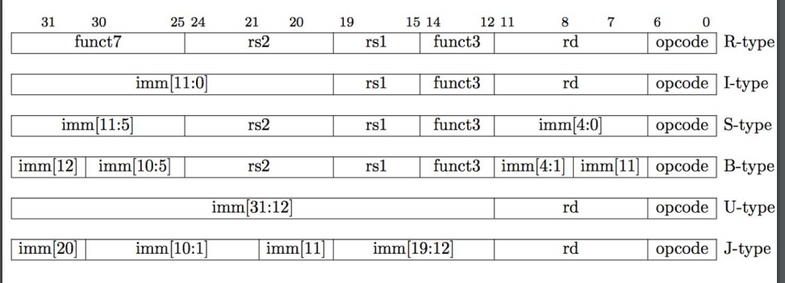

Slide 48
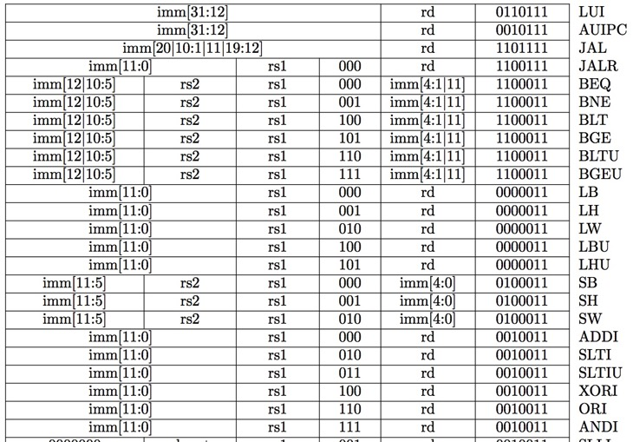
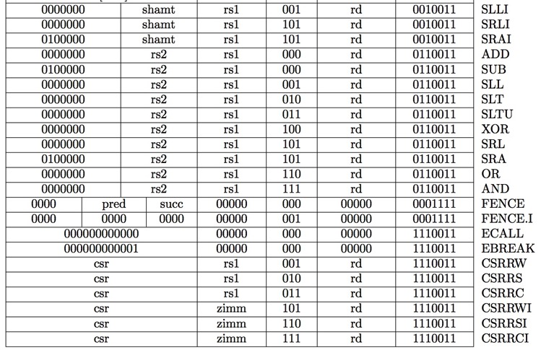
RV32I, 9-bit ISA!
inst[30]
inst[14:12]
inst[6:2]
Not in 044252

Slide 49
ROM-based Control
10-bit address (inputs)
inst[14:12]|Inst[6:2]
BrEq
BrLT
8
PCSel
ROM
(how many words? Bits per word?)
3
ImmSel[2:0]
BrUn
ASel
BSel
3
ALUSel[3:0]
MemRW
RegWEn
2
WBSel[1:0]
14 data bits (outputs)

Slide 50
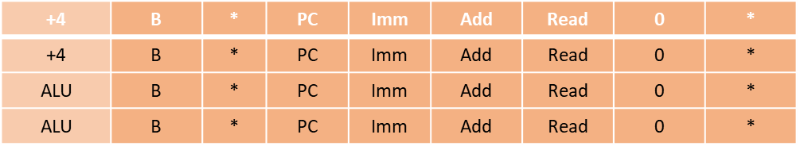
ROM Controller Implementation
add
Control Word for add
.
.
.
Address
Decoder
Inst[]
BrEQ
BrLT
10
.
.
.
beq
bnq
beq
bnq
Controller output (PCSel, ImmSel, …)

Slide 51
Instruction Timing
IF | ID | EX | MEM | WB | Total
I-MEM | Reg Read | ALU | D-MEM | Reg W
200 ps | 100 ps | 200 ps | 200 ps | 100 ps | 800 ps

Slide 52
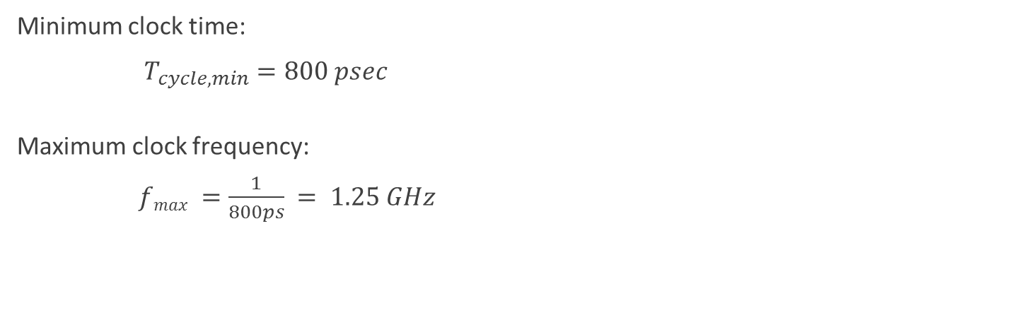
Instruction Timing
Instr | IF = 200ps | ID = 100ps | ALU = 200ps | MEM=200ps | WB = 100ps | Total
add | X | X | X |  | X | 600ps
beq | X | X | X |  |  | 500ps
jal | X | X | X |  |  | 500ps
lw | X | X | X | X | X | 800ps
sw | X | X | X | X |  | 700ps
Minimum clock time:
$T_{cycle, min}=800 psec$
Maximum clock frequency:
$fmax =\frac{1}{800ps} = 1.25 GHz$

Slide 53
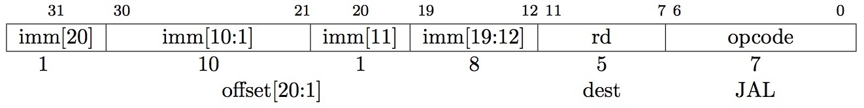
Implementing jal Instruction
JAL:
Reg[rd] = PC+4 (default rd = ra)
PC = PC + offset (PC-relative jump)

Slide 54
Single-Cycle RISC-V RV32I Datapath
jal rd, label
+4
Reg[]
pc
pc+4
pc
wb
1
alu
1
DataD
Reg[rs1]
ALU
2
alu
0
DMEM
0
IMEM
inst[11:7]
AddrD
Addr
1
pc+4
Branch Comp.
Reg[rs2]
DataR
wb
inst[19:15]
AddrA
DataA
0
0
DataW
mem
inst[24:20]
AddrB
DataB
1
inst[31:7]
Imm.
Gen
ALU ctrl
imm[31:0]
funct 3,7
PCSel
inst[14:12|6:2]
ImmSel
RegWEn
BrUn
BrEq
BrLT
BSel
ASel
ALUSel
MemRW
WBSel

Slide 55
Single-Cycle RISC-V RV32I Datapath
jal rd, label
+4
Reg[]
pc
pc+4
pc
wb
1
alu
1
DataD
Reg[rs1]
ALU
2
alu
0
DMEM
0
IMEM
inst[11:7]
AddrD
Addr
1
pc+4
Branch Comp.
Reg[rs2]
DataR
wb
inst[19:15]
AddrA
DataA
0
0
DataW
mem
inst[24:20]
AddrB
DataB
1
inst[31:7]
Imm.
Gen
ALU ctrl
imm[31:0]
funct 3,7
PCSel
inst[14:12|6:2]
ImmSel
RegWEn
BrUn
BrEq
BrLT
BSel
ASel
ALUSel
MemRW
WBSel

Slide 56
Single-Cycle RISC-V RV32I Datapath
jal rd, label
+4
Reg[]
pc
pc+4
pc
wb
1
alu
1
DataD
Reg[rs1]
ALU
2
alu
0
DMEM
0
IMEM
inst[11:7]
AddrD
Addr
1
pc+4
Branch Comp.
Reg[rs2]
DataR
wb
inst[19:15]
AddrA
DataA
0
0
DataW
mem
inst[24:20]
AddrB
DataB
1
inst[31:7]
Imm.
Gen
ALU ctrl
imm[31:0]
funct 3,7
PCSel
inst[14:12|6:2]
ImmSel
RegWEn
BrUn
BrEq
BrLT
BSel
ASel
ALUSel
MemRW
WBSel

Slide 57
Single-Cycle RISC-V RV32I Datapath
jal rd, label
+4
Reg[]
pc
pc+4
pc
wb
1
alu
1
DataD
Reg[rs1]
ALU
2
alu
0
DMEM
0
IMEM
inst[11:7]
AddrD
Addr
1
pc+4
Branch Comp.
Reg[rs2]
DataR
wb
inst[19:15]
AddrA
DataA
0
0
DataW
mem
inst[24:20]
AddrB
DataB
1
inst[31:7]
Imm.
Gen
ALU ctrl
imm[31:0]
funct 3,7
PCSel
inst[14:12|6:2]
ImmSel
RegWEn
BrUn
BrEq
BrLT
BSel
ASel
ALUSel
MemRW
WBSel

Slide 58
Single-Cycle RISC-V RV32I Datapath
jal rd, label
+4
Reg[]
pc
pc+4
pc
wb
1
alu
1
DataD
Reg[rs1]
ALU
2
alu
0
DMEM
0
IMEM
inst[11:7]
AddrD
Addr
1
pc+4
Branch Comp.
Reg[rs2]
DataR
wb
inst[19:15]
AddrA
DataA
0
0
DataW
mem
inst[24:20]
AddrB
DataB
1
inst[31:7]
Imm.
Gen
ALU ctrl
imm[31:0]
funct 3,7
PCSel
inst[14:12|6:2]
ImmSel
RegWEn
BrUn
BrEq
BrLT
BSel
ASel
ALUSel
MemRW
WBSel

Slide 59
Single-Cycle RISC-V RV32I Datapath
jal rd, label
+4
Reg[]
pc
pc+4
pc
wb
1
alu
1
DataD
Reg[rs1]
ALU
2
alu
0
DMEM
0
IMEM
inst[11:7]
AddrD
Addr
1
pc+4
Branch Comp.
Reg[rs2]
DataR
wb
inst[19:15]
AddrA
DataA
0
0
DataW
mem
inst[24:20]
AddrB
DataB
1
Add
inst[31:7]
Imm.
Gen
ALU ctrl
imm[31:0]
1
funct 3,7
UJ
1
d
1
1
UJ
Read
10
PCSel
inst[14:12|6:2]
ImmSel
RegWEn
BrUn
BrEq
BrLT
BSel
ASel
ALUSel
MemRW
WBSel

Slide 60
Adding New Instructions

Slide 61
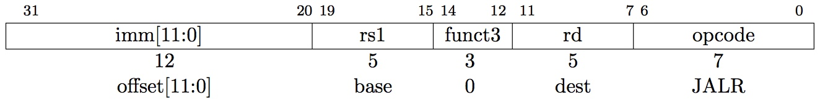
Implementing JALR Instruction (I-Format)
jalr rd, rs, imm
JALR:
Reg[rd] = PC + 4
PC = Reg[rs1] + immediate

Slide 62
Single-Cycle RISC-V RV32I Datapath
jalr rd, rs, imm
+4
Reg[]
pc
pc+4
pc
wb
1
alu
1
DataD
Reg[rs1]
ALU
2
alu
0
DMEM
0
IMEM
inst[11:7]
AddrD
Addr
1
pc+4
Branch Comp.
Reg[rs2]
DataR
wb
inst[19:15]
AddrA
DataA
0
0
DataW
mem
inst[24:20]
AddrB
DataB
1
Add
inst[31:7]
Imm.
Gen
ALU ctrl
imm[31:0]
1
funct 3,7
UJ
1
d
1
1
UJ
Read
10
PCSel
inst[14:12|6:2]
ImmSel
RegWEn
BrUn
BrEq
BrLT
BSel
ASel
ALUSel
MemRW
WBSel

Slide 63
Single-Cycle RISC-V RV32I Datapath
jalr rd, rs, imm
+4
Reg[]
pc
pc+4
pc
wb
1
alu
1
DataD
Reg[rs1]
ALU
2
alu
0
DMEM
0
IMEM
inst[11:7]
AddrD
Addr
1
pc+4
Branch Comp.
Reg[rs2]
DataR
wb
inst[19:15]
AddrA
DataA
0
0
DataW
mem
inst[24:20]
AddrB
DataB
1
Add
inst[31:7]
Imm.
Gen
ALU ctrl
imm[31:0]
1
funct 3,7
J
1
d
1
1
UJ
Read
10
PCSel
inst[14:12|6:2]
ImmSel
RegWEn
BrUn
BrEq
BrLT
BSel
ASel
ALUSel
MemRW
WBSel

Slide 64
Single-Cycle RISC-V RV32I Datapath
jalr rd, rs, imm
+4
Reg[]
pc
pc+4
pc
wb
1
alu
1
DataD
Reg[rs1]
ALU
2
alu
0
DMEM
0
IMEM
inst[11:7]
AddrD
Addr
1
pc+4
Branch Comp.
Reg[rs2]
DataR
wb
inst[19:15]
AddrA
DataA
0
0
DataW
mem
inst[24:20]
AddrB
DataB
1
Add
inst[31:7]
Imm.
Gen
ALU ctrl
imm[31:0]
1
funct 3,7
i
1
d
1
0
i
Read
10
PCSel
inst[14:12|6:2]
ImmSel
RegWEn
BrUn
BrEq
BrLT
BSel
ASel
ALUSel
MemRW
WBSel

Slide 65
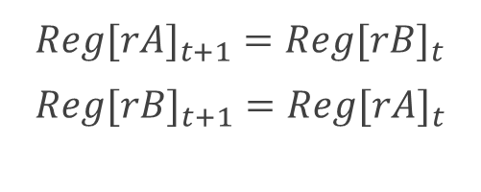
Implementing swap Instruction
Swap rA, rB
$Reg[r{A]}_{t+1}=Reg[r{B]}_{t}$
$Reg[r{B]}_{t+1}=Reg[r{A]}_{t}$

Slide 66
Single-Cycle RISC-V RV32I Datapath
swap rd1, rd2
+4
Reg[]
pc
pc+4
pc
wb
1
alu
1
DataD
Reg[rs1]
ALU
2
alu
0
DMEM
0
IMEM
inst[11:7]
AddrD
Addr
1
pc+4
Branch Comp.
Reg[rs2]
DataR
wb
inst[19:15]
AddrA
DataA
0
0
DataW
mem
inst[24:20]
AddrB
DataB
1
inst[31:7]
Imm.
Gen
ALU ctrl
imm[31:0]
funct 3,7
PCSel
inst[14:12|6:2]
ImmSel
RegWEn
BrUn
BrEq
BrLT
BSel
ASel
ALUSel
MemRW
WBSel

Slide 67
Implementing lia Instruction
lia rd, rs1, rs2
lia – Load Incremented address:
Interpretation:
Loads a word from an address calculated by the sum of the values of registers rs1 and rs2 to register rd:
Reg[rd] = Mem[rs1+rs2]

Slide 68
Single-Cycle RISC-V RV32I Datapath
lia rd, rs1, rs2
+4
Reg[]
pc
pc+4
pc
wb
1
alu
1
DataD
Reg[rs1]
ALU
2
alu
0
DMEM
0
IMEM
inst[11:7]
AddrD
Addr
1
pc+4
Branch Comp.
Reg[rs2]
DataR
wb
inst[19:15]
AddrA
DataA
0
0
DataW
mem
inst[24:20]
AddrB
DataB
1
inst[31:7]
Imm.
Gen
ALU ctrl
imm[31:0]
funct 3,7
PCSel
inst[14:12|6:2]
ImmSel
RegWEn
BrUn
BrEq
BrLT
BSel
ASel
ALUSel
MemRW
WBSel

Slide 69
Single-Cycle RISC-V RV32I Datapath
lia rd, rs1, rs2
+4
Reg[]
pc
pc+4
pc
wb
1
alu
1
DataD
Reg[rs1]
ALU
2
alu
0
DMEM
0
IMEM
inst[11:7]
AddrD
Addr
1
pc+4
Branch Comp.
Reg[rs2]
DataR
wb
inst[19:15]
AddrA
DataA
0
0
DataW
mem
inst[24:20]
AddrB
DataB
1
inst[31:7]
Imm.
Gen
ALU ctrl
imm[31:0]
funct 3,7
PCSel
inst[14:12|6:2]
ImmSel
RegWEn
BrUn
BrEq
BrLT
BSel
ASel
ALUSel
MemRW
WBSel

Slide 70
Single-Cycle RISC-V RV32I Datapath
lia rd, rs1, rs2
+4
Reg[]
pc
pc+4
pc
wb
1
alu
1
DataD
Reg[rs1]
ALU
2
alu
0
DMEM
0
IMEM
inst[11:7]
AddrD
Addr
1
pc+4
Branch Comp.
Reg[rs2]
DataR
wb
inst[19:15]
AddrA
DataA
0
0
DataW
mem
inst[24:20]
AddrB
DataB
1
inst[31:7]
Imm.
Gen
ALU ctrl
imm[31:0]
funct 3,7
PCSel
inst[14:12|6:2]
ImmSel
RegWEn
BrUn
BrEq
BrLT
BSel
ASel
ALUSel
MemRW
WBSel

Slide 71
Single-Cycle RISC-V RV32I Datapath
lia rd, rs1, rs2
+4
Reg[]
pc
pc+4
pc
wb
1
alu
1
DataD
Reg[rs1]
ALU
2
alu
0
DMEM
0
IMEM
inst[11:7]
AddrD
Addr
1
pc+4
Branch Comp.
Reg[rs2]
DataR
wb
inst[19:15]
AddrA
DataA
0
0
DataW
mem
inst[24:20]
AddrB
DataB
1
inst[31:7]
Imm.
Gen
ALU ctrl
imm[31:0]
funct 3,7
PCSel
inst[14:12|6:2]
ImmSel
RegWEn
BrUn
BrEq
BrLT
BSel
ASel
ALUSel
MemRW
WBSel

Slide 72
Single-Cycle RISC-V RV32I Datapath
lia rd, rs1, rs2
+4
Reg[]
pc
pc+4
pc
wb
1
alu
1
DataD
Reg[rs1]
ALU
2
alu
0
DMEM
0
IMEM
inst[11:7]
AddrD
Addr
1
pc+4
Branch Comp.
Reg[rs2]
DataR
wb
inst[19:15]
AddrA
DataA
0
0
DataW
mem
inst[24:20]
AddrB
DataB
1
inst[31:7]
Imm.
Gen
ALU ctrl
imm[31:0]
funct 3,7
PCSel
inst[14:12|6:2]
ImmSel
RegWEn
BrUn
BrEq
BrLT
BSel
ASel
ALUSel
MemRW
WBSel

Slide 73
Single-Cycle RISC-V RV32I Datapath
lia rd, rs1, rs2
+4
Reg[]
pc
pc+4
pc
wb
1
alu
1
DataD
Reg[rs1]
ALU
2
alu
0
DMEM
0
IMEM
inst[11:7]
AddrD
Addr
1
pc+4
Branch Comp.
Reg[rs2]
DataR
wb
inst[19:15]
AddrA
DataA
0
0
DataW
mem
inst[24:20]
AddrB
DataB
1
Add
inst[31:7]
Imm.
Gen
ALU ctrl
imm[31:0]
0
funct 3,7
d
1
d
0
0
R
Read
00
PCSel
inst[31:0]
ImmSel
RegWEn
BrUn
BrEq
BrLT
BSel
ASel
ALUSel
MemRW
WBSel

Slide 74
Implementing stsi Instruction
stsi rs1, rs2, imm
stsi – Store Sum Immediate
Interpretation:
Stores rs1 + immediate to the memory in address rs2:
Mem[rs2] = Reg[rs1] + immediate

Slide 75
Single-Cycle RISC-V RV32I Datapath
stsi rs1, rs2, imm
+4
Reg[]
pc
pc+4
pc
wb
1
alu
1
DataD
Reg[rs1]
ALU
2
alu
0
DMEM
0
IMEM
inst[11:7]
AddrD
Addr
1
pc+4
Branch Comp.
Reg[rs2]
DataR
wb
inst[19:15]
AddrA
DataA
0
0
DataW
mem
inst[24:20]
AddrB
DataB
1
inst[31:7]
Imm.
Gen
ALU ctrl
imm[31:0]
funct 3,7
PCSel
inst[14:12|6:2]
ImmSel
RegWEn
BrUn
BrEq
BrLT
BSel
ASel
ALUSel
MemRW
WBSel

Slide 76
Single-Cycle RISC-V RV32I Datapath
stsi rs1, rs2, imm
+4
Reg[]
pc
pc+4
pc
wb
1
alu
1
DataD
Reg[rs1]
ALU
2
alu
0
DMEM
0
IMEM
inst[11:7]
AddrD
Addr
1
pc+4
Branch Comp.
Reg[rs2]
DataR
wb
inst[19:15]
AddrA
DataA
0
0
DataW
mem
inst[24:20]
AddrB
DataB
1
inst[31:7]
Imm.
Gen
ALU ctrl
imm[31:0]
funct 3,7
PCSel
inst[14:12|6:2]
ImmSel
RegWEn
BrUn
BrEq
BrLT
BSel
ASel
ALUSel
MemRW
WBSel

Slide 77
Single-Cycle RISC-V RV32I Datapath
stsi rs1, rs2, imm
+4
Reg[]
pc
pc+4
pc
wb
1
alu
1
DataD
Reg[rs1]
ALU
2
alu
0
DMEM
0
IMEM
inst[11:7]
AddrD
Addr
1
pc+4
Branch Comp.
Reg[rs2]
DataR
wb
inst[19:15]
AddrA
DataA
0
0
DataW
mem
inst[24:20]
AddrB
DataB
1
inst[31:7]
Imm.
Gen
ALU ctrl
imm[31:0]
funct 3,7
PCSel
inst[14:12|6:2]
ImmSel
RegWEn
BrUn
BrEq
BrLT
BSel
ASel
ALUSel
MemRW
WBSel

Slide 78
Single-Cycle RISC-V RV32I Datapath
stsi rs1, rs2, imm
+4
Reg[]
pc
pc+4
pc
wb
1
alu
1
DataD
Reg[rs1]
ALU
2
alu
0
DMEM
0
IMEM
inst[11:7]
AddrD
Addr
1
pc+4
Branch Comp.
Reg[rs2]
DataR
wb
inst[19:15]
AddrA
DataA
0
0
DataW
mem
inst[24:20]
AddrB
DataB
1
inst[31:7]
Imm.
Gen
ALU ctrl
imm[31:0]
funct 3,7
PCSel
inst[14:12|6:2]
ImmSel
RegWEn
BrUn
BrEq
BrLT
BSel
ASel
ALUSel
MemRW
WBSel

Slide 79
Single-Cycle RISC-V RV32I Datapath
stsi rs1, rs2, imm
+4
Reg[]
pc
pc+4
pc
wb
1
alu
DataD
ALU
0
2
alu
1
Reg[rs1]
0
DMEM
IMEM
inst[11:7]
1
1
0
AddrD
Reg[rs2]
Addr
Data
wb
pc+4
Branch Comp.
0
0
inst[19:15]
AddrA
DataA
mem
1
DataW
inst[24:20]
AddrB
DataB
inst[31:7]
Imm.
Gen
ALU ctrl
imm[31:0]
funct 3,7
PCSel
inst[14:12|6:2]
ImmSel
RegWEn
BrUn
BrEq
BrLT
BSel
ASel
ALUSel
MemRW
WBSel

Slide 80
Single-Cycle RISC-V RV32I Datapath
stsi rs1, rs2, imm
+4
Reg[]
pc
pc+4
pc
wb
1
alu
DataD
ALU
0
2
alu
1
Reg[rs1]
0
DMEM
IMEM
inst[11:7]
1
1
0
AddrD
Reg[rs2]
Addr
Data
wb
pc+4
Branch Comp.
0
0
inst[19:15]
AddrA
DataA
1
mem
1
DataW
inst[24:20]
AddrB
DataB
0
inst[31:7]
Imm.
Gen
ALU ctrl
imm[31:0]
funct 3,7
PCSel
inst[14:12|6:2]
ImmSel
RegWEn
BrUn
BrEq
BrLT
BSel
ASel
ALUSel
MemRW
WBSel

Slide 81
Single-Cycle RISC-V RV32I Datapath
stsi rs1, rs2, imm
+4
Reg[]
pc
pc+4
pc
wb
1
alu
DataD
ALU
0
2
alu
1
Reg[rs1]
0
DMEM
IMEM
inst[11:7]
1
1
0
AddrD
Reg[rs2]
Addr
Data
wb
pc+4
Branch Comp.
0
0
inst[19:15]
AddrA
DataA
1
mem
1
DataW
inst[24:20]
AddrB
DataB
0
inst[31:7]
Imm.
Gen
ALU ctrl
imm[31:0]
funct 3,7
PCSel
inst[14:12|6:2]
ImmSel
RegWEn
BrUn
BrEq
BrLT
BSel
ASel
ALUSel
MemRW
WBSel

Slide 82
Single-Cycle RISC-V RV32I Datapath
stsi rs1, rs2, imm
+4
Reg[]
pc
pc+4
pc
wb
1
alu
DataD
ALU
0
2
alu
1
Reg[rs1]
0
DMEM
IMEM
inst[11:7]
1
1
0
AddrD
Reg[rs2]
Addr
Data
wb
pc+4
Branch Comp.
0
0
inst[19:15]
AddrA
DataA
1
mem
1
DataW
inst[24:20]
AddrB
DataB
0
Add
inst[31:7]
Imm.
Gen
ALU ctrl
imm[31:0]
0
funct 3,7
S
0
d
0
S
1
Write
d
1
PCSel
inst[14:12|6:2]
ImmSel
RegWEn
BrUn
BrEq
BrLT
BSel
ASel
ALUSel
MemRW
WBSel

Slide 83
Zero memory offset
הוחלט לעדכן את סט הפקודות כך שלא תהיה אפשרות לציין בפקודות גישה לזיכרון את ה- offset ביחס לכתובת הבסיס. כתובת הגישה הרצויה תופיע ישירות ברגיסטר. למעשה, הפורמט המקורי של הפקודות האלה יהפוך לפסאודו-פקודה, לדוגמא
lw rd, 104(rs)
יתורגם ל:
addi rs, rs, 104
lw rd, rs
כנ"ל גם לגבי sw.
איזה שינוי יש לבצע במסלול הנתונים ובקווי הבקרה בעקבות העדכון הנ"ל?

Slide 84
Single-Cycle RISC-V RV32I Datapath
+4
Reg[]
pc
pc+4
pc
wb
1
alu
1
DataD
Reg[rs1]
ALU
2
alu
0
DMEM
0
IMEM
inst[11:7]
AddrD
Addr
1
pc+4
Branch Comp.
Reg[rs2]
DataR
wb
inst[19:15]
AddrA
DataA
0
0
DataW
mem
inst[24:20]
AddrB
DataB
1
inst[31:7]
Imm.
Gen
ALU ctrl
imm[31:0]
funct 3,7
PCSel
inst[14:12|6:2]
ImmSel
RegWEn
BrUn
BrEq
BrLT
BSel
ASel
ALUSel
MemRW
WBSel

Slide 85
Single-Cycle RISC-V RV32I Datapath
+4
Reg[]
pc
pc+4
pc
wb
1
alu
1
DataD
Reg[rs1]
ALU
2
alu
0
DMEM
0
IMEM
inst[11:7]
AddrD
Addr
1
pc+4
Branch Comp.
Reg[rs2]
DataR
wb
inst[19:15]
AddrA
DataA
0
0
DataW
mem
inst[24:20]
AddrB
DataB
1
inst[31:7]
Imm.
Gen
ALU ctrl
imm[31:0]
funct 3,7
PCSel
inst[14:12|6:2]
ImmSel
RegWEn
BrUn
BrEq
BrLT
BSel
ASel
ALUSel
MemRW
WBSel

Slide 86
Single-Cycle RISC-V RV32I Datapath
+4
Reg[]
pc
pc+4
pc
wb
1
alu
1
DataD
Reg[rs1]
ALU
2
alu
0
DMEM
0
IMEM
inst[11:7]
AddrD
Addr
1
pc+4
Branch Comp.
Reg[rs2]
DataR
wb
inst[19:15]
AddrA
DataA
0
0
DataW
mem
inst[24:20]
AddrB
DataB
1
inst[31:7]
Imm.
Gen
ALU ctrl
imm[31:0]
funct 3,7
PCSel
inst[14:12|6:2]
ImmSel
RegWEn
BrUn
BrEq
BrLT
BSel
ASel
ALUSel
MemRW
WBSel

Slide 87
Zero memory offset
השינוי האחרון מעלה סימני שאלה לגבי היעילות שלו. ייתכן וכעת ניתן יהיה להגדיר זמן מחזור שעון קטן יותר. מאידך, מספר רב של פקודות גישה לזיכרון יגדיל את מספר הפקודות המעשי אשר המעבד יצטרך לבצע.
בהנחת זמני השהיה הבאים של רכיבים שונים במערכת, מהו האחוז המקסימלי של פקודות גישה לזיכרון, אשר יצדיק את השינוי הנ"ל?
Instruction memory | Register read | ALU operation | Data memory | Register write
2 | 1 | 2 | 2 | 1
הניחו ששאר הלוגיקה הצירופית אינה מוסיפה להשהיה.

Slide 88
לפני השינוי זמן מחזור השעון נקבע עפ"י:
Instruction Class | Instruction memory | Register read | ALU operation | Data memory | Register write | Total
 | 2 | 1 | 2 | 2 | 1
ALU type | v | v | v |  | v | 6ns
Load word | v | v | v | v | v | 8ns
Store word | v | v | v | v |  | 7ns
Branch | v | v | v |  |  | 5ns
Jump | v |  |  |  |  | 2ns
אחרי השינוי:
Instruction Class | Instruction memory | Register read | ALU operation | Data memory | Register write | Total
 | 2 | 1 | 2 | 2 | 1
ALU type | v | v | v |  | v | 6ns
Load word | v | v |  | v | V | 6ns
Store word | v | v |  | v |  | 5ns
Branch | v | v | v |  |  | 5ns
Jump | v |  |  |  |  | 2ns

Slide 89

Zero memory offset
זמן מחזור שעון ישן – 8ns
זמן מחזור שעון חדש – 6ns
נניח N הוא מספר הפקודות בתוכנית המקורית ו- a הוא החלק היחסי של פקודות גישה לזיכרון בתוכנית זו.
מספר הפקודות בתכנית החדשה הוא $\left(1+a\right)∙N$
$\left(1+a\right)∗N∗6≤ N∗8$
$$a≤\frac{1}{3} → a_{max}=\frac{1}{3}$$

Slide 90
שאלות על הוידאו?

Slide 91
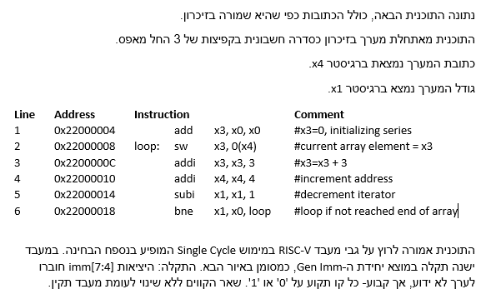
שאלה 3 – מועד ב 2018 אביב

Slide 92
+4
Reg[]
pc
pc+4
pc
wb
1
alu
1
DataD
Reg[rs1]
ALU
2
alu
0
DMEM
0
IMEM
inst[11:7]
AddrD
Addr
1
pc+4
Branch Comp.
Reg[rs2]
DataR
wb
inst[19:15]
AddrA
DataA
0
0
DataW
mem
inst[24:20]
AddrB
DataB
1
inst[31:7]
Imm.
Gen
ALU ctrl
imm[31:0]
funct 3,7
PCSel
inst[14:12|6:2]
ImmSel
RegWEn
BrUn
BrEq
BrLT
BSel
ASel
ALUSel
MemRW
WBSel
אילו פקודות מהתכונית הנתונה מושפעות באופן ישיר מהתקלה ותבצענה פעולה שונה מהמתבקש בתוכנית המניחה כי המעבד תקין?

Slide 93
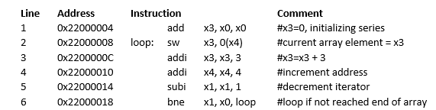
האם מושפעת מהשינוי? | פקודה
 | add
 | sw
 | addi
 | subi
 | bne
לא
כן
כן
כן
כן
Notes:
פקודה ראשונה משתמשים ב3 רגיסטרים הקבוע נזרק
באחרות יש שימוש בקבוע

Slide 94
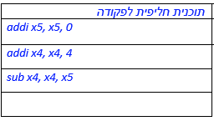
מסתבר שמאחר והערך imm[7:4] הינו קבוע ניתן לשנות את התוכנית כך שהיא תרוץ באופן תקין גם על מעבד עם התקלה הנ"ל. רשמו תוכנית חליפית בת עד 4 פקודות שיבצעו את הפעולה addi אם הייתה הפקודה מבוצעת במעבד תקין.
(ניתן להשתמש ברגיסטרים נוספים במידת הצורך).
X5 = 0 + C
X4 = X4+ C
X4 = X4 –X5

Slide 95
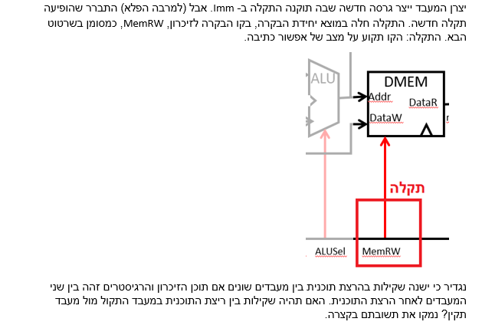
לא, אין שקילות מכיוון שבמעבד התקול כתיבה לזיכרון מתאפשרת בזמן פקודות שאינן SW כך שדורסים כל מיני תאי זיכרון לפי הכתובת המועברת ע"י ה-ALU, כאשר זו אינה כתובת אלא חישוב כלשהו.

Slide 96
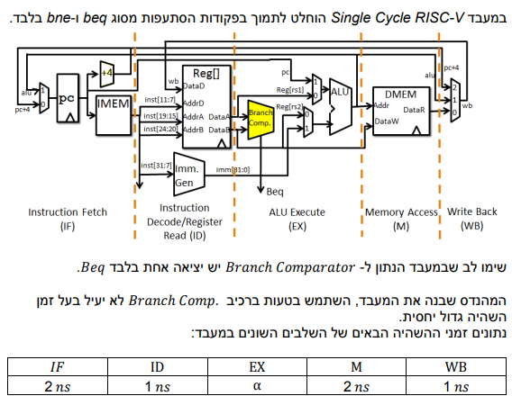
שאלה 12 – מועד א 2019 חורף

Slide 97
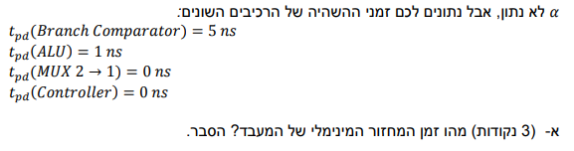
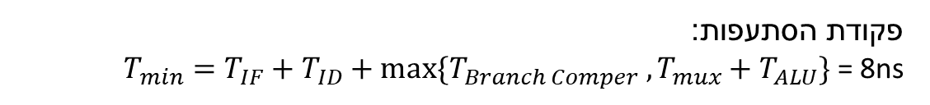
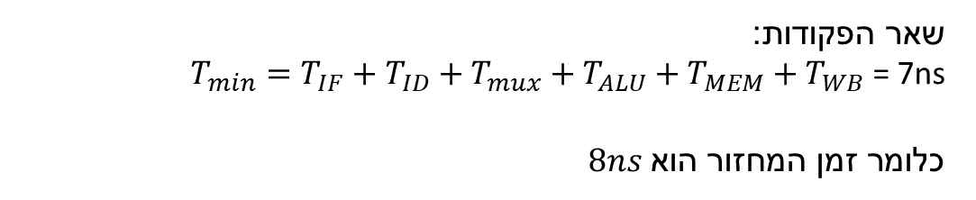
נחלק את הפקודות לשתי קבוצות לפי השימוש ברכיב ההסתעפות:
פקודת הסתעפות: $T_{min}=T_{IF}+T_{ID}+max⁡\{T_{Branch Comper} , T_{mux}+T_{ALU}\}$ = 8ns
שאר הפקודות:
$T_{min}=T_{IF}+T_{ID}+T_{mux}+T_{ALU}+T_{MEM}+T_{WB}$ = 7ns
$8ns\text{כלומר זמן המחזור הוא}$

Slide 98
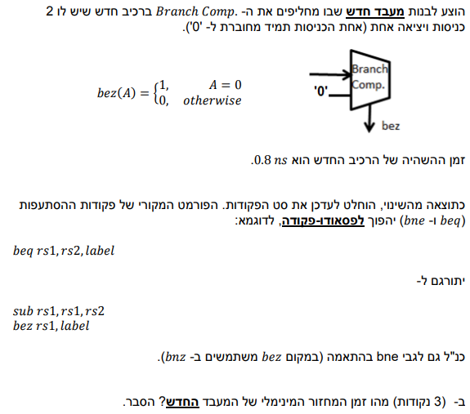
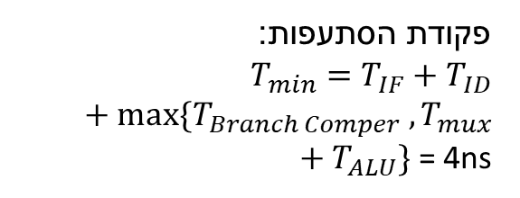
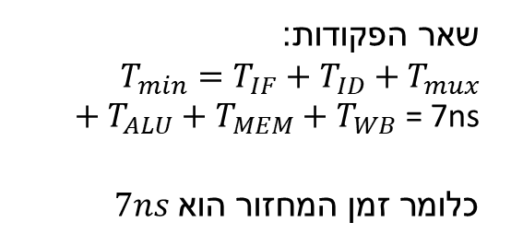
באופן דומה לסעיף הקודם נחלק את הפקודות לשתי קבוצות לפי השימוש ברכיב ההסתעפות:
מה השתנה?
פקודת הסתעפות: $T_{min}=T_{IF}+T_{ID}+max⁡\{T_{Branch Comper} , T_{mux}+T_{ALU}\}$ = 4ns
שאר הפקודות:
$T_{min}=T_{IF}+T_{ID}+T_{mux}+T_{ALU}+T_{MEM}+T_{WB}$ = 7ns
$7ns\text{כלומר זמן המחזור הוא}$

Slide 99



נשים לב שזמן המחזור של המעבד החדש קצר יותר ביחס למעבד הישן בעוד שפקודת הסתעפות ארוכה יותר מפקודת הסתעפות במעבד הישן.
beq x0 x0 label
add x0 x0 x0

Slide 100
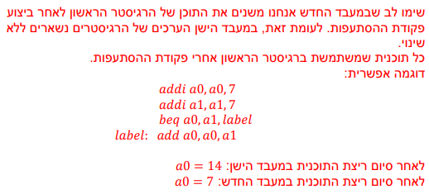
ה- נגדיר כי ישנה שקילות בהרצת תוכנית בין מעבדים שונים אם תוכן הזיכרון והרגיסטרים זהה בין שני המעבדים לאחר הרצת התוכנית. האם ישנה שקילות בין שני המעבדים?
הסבירו את תשובתכם.

Slide 101
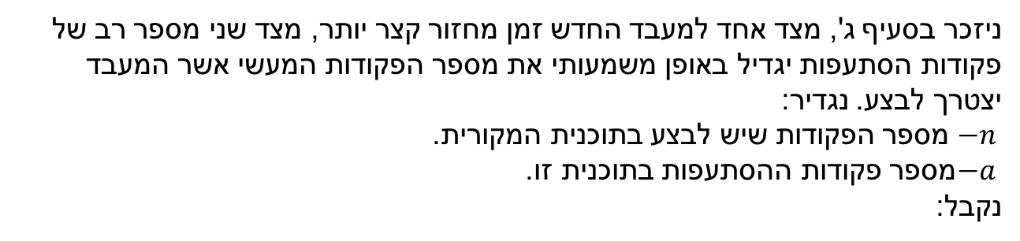
ו- בסעיף זה בלבד מניחים כי אין את הבעיה מסעיף קודם (הרצת התוכנית על מעבדים שונים שקולה). בהינתן תוכנית כלשהי כיצד נחליט ביזה מעבד עדיף להריץ אותה? הסבירו.
רמז 1: חשבו על כמות הפקודות מהסוגים השונים
רמז 2: היזכרו בתרגיל האחרון מהתרגול של מארון
ניזכר בסעיף ג', מצד אחד למעבד החדש זמן מחזור קצר יותר, מצד שני מספר רב של פקודות הסתעפות יגדיל באופן משמעותי את מספר הפקודות המעשי אשר המעבד יצטרך לבצע. נגדיר:
מספר הפקודות שיש לבצע בתוכנית המקורית. $−n$
מספר פקודות ההסתעפות בתוכנית זו.$−a$
נקבל:

Slide 102
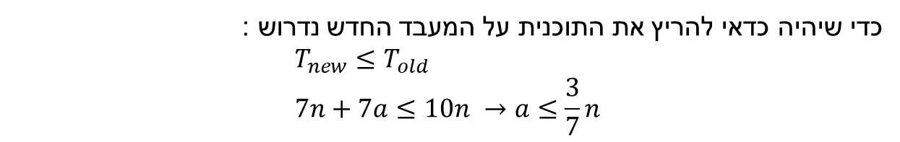

$$T_{old}\left(prog\right)=n ∗T_{min,old}=10n$$
$$T_{old}\left(prog\right)=(n+a) ∗T_{min,new}=7(n+a)$$
כדי שיהיה כדאי להריץ את התוכנית על המעבד החדש נדרוש :
$$T_{new}≤T_{old} \\ 7n+7a≤10n →a≤\frac{3}{7}n$$
$$\frac{3}{7}$$
כלומר כל עוד החלק היחסי של פקודות ההסתעפות מתוך סך הפקודות בתוכנית קטן מ –
נעדיף להריץ על המעבד החדש. אחרת, על המעבד הישן.

Slide 103
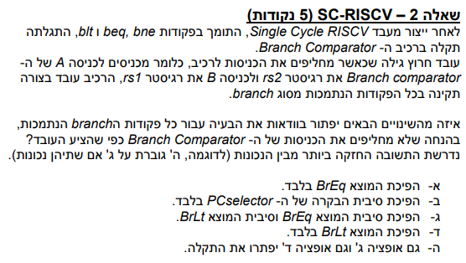
שאלה 2 – מועד ב 2019 חורף

Slide 104
+4
Reg[]
pc
pc+4
pc
wb
1
alu
1
DataD
Reg[rs1]
ALU
2
alu
0
DMEM
0
IMEM
inst[11:7]
AddrD
Addr
1
pc+4
Branch Comp.
Reg[rs2]
DataR
wb
inst[19:15]
AddrA
DataA
0
0
DataW
mem
inst[24:20]
AddrB
DataB
1
beq rs1, rs2, label
Add
inst[31:7]
Imm.
Gen
ALU ctrl
imm[31:0]
BrEq
funct 3,7
SB
0
1
1
1
SB
Read
PCSel
inst[14:12|6:2]
ImmSel
RegWEn
BrUn
BrEq
BrLT
BSel
ASel
ALUSel
MemRW
WBSel
מכיוון שהמוצא הקובע כי הכניסות שוות עובד בצורה תקינה היפוכו יביא לפעולה לא תקינה של
לכן התשובה הנכונה היא ד' (שאר התשובות כוללות היפוך של ביט זה).beq

Slide 105
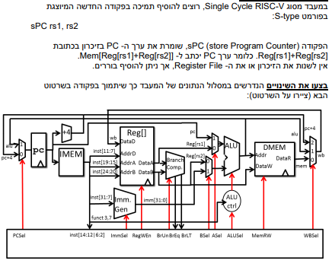
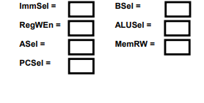

שאלה 10 – מועד א 2019 אביב
כתבו מהם קווי הבקרה לביצוע הפקודה

Slide 106
$$Mem\left[rs1+rs2\right]=PC$$
+4
Reg[]
pc
pc+4
pc
wb
1
alu
1
DataD
Reg[rs1]
ALU
2
alu
0
DMEM
0
IMEM
inst[11:7]
AddrD
Addr
1
pc+4
Branch Comp.
Reg[rs2]
DataR
wb
inst[19:15]
AddrA
DataA
0
0
DataW
mem
inst[24:20]
AddrB
DataB
1
inst[31:7]
Imm.
Gen
ALU ctrl
imm[31:0]
funct 3,7
PCSel
inst[14:12|6:2]
ImmSel
RegWEn
BrUn
BrEq
BrLT
BSel
ASel
ALUSel
MemRW
WBSel

Slide 107
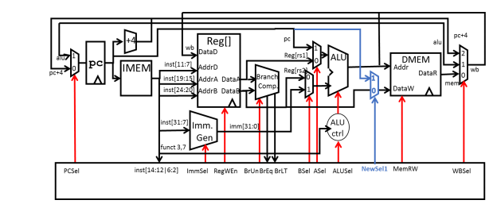
כעת כל שנותר לנו לעשות הוא לקבוע את קווי הבקרה
ניזכר בסוגי הפקודות השונים

Slide 108

באיזה פורמט כדאי לנו להשתמש?
אנו משתמשים ב 2 רגיסטרים ולכן נשתמש בפורמט
$$S$$

Slide 109


S
0
$$∅$$
0
S
1
0
W
$$∅$$
0

Slide 110
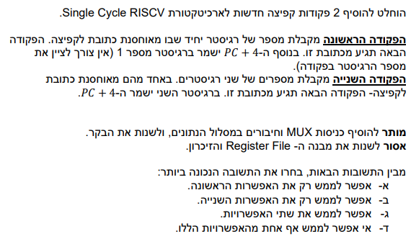
שאלה 7 – מועד ב 2019 קיץ

